Slide 1
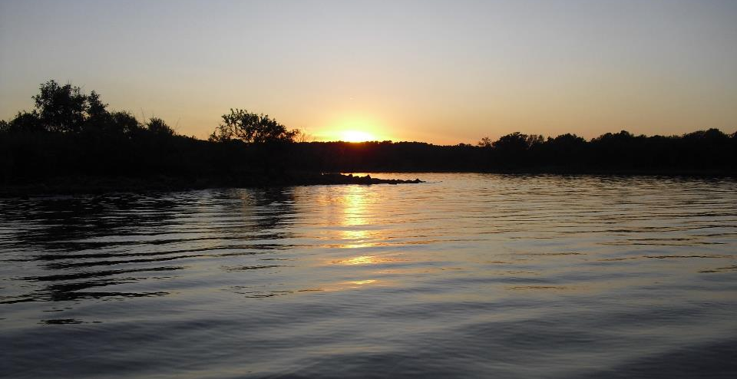
MCM-3 Monitoring: DWFS and IDDE Procedures
GCSA Workshop
OKR04 MCM-3 and Part IV Sampling and Field Methods
Presented by INCOG
Nienhuis Park
May 18, 2022

Slide 2
OKR04 MCM-3 IDDE Requirements
Part V.C.3.a states: “Implement and enforce a program to detect and eliminate illicit discharges, including illegal dumping and on-site sewage disposal systems, into your small MS4. Your program must include dry weather field screening (DWFS), identify non-stormwater flows, and new elements should be developed and implemented as necessary. At a minimum, your program must adopt the following procedures:”
This is followed by action items listed in Part V.C.3.a.i – viii.
DWFS is not broken out in OKR04 as a separate action item.
Rather, DWFS is considered an integral part of the overall IDDE program.

Slide 3
OKR04 MCM-3 IDDE Requirements
(Items in blue text can apply to DWFS)
Part V.C.3.a.i – viii lists key MCM-3 requirements:
Identify priority areas.
Trace or investigate the source of an illicit discharge w/in 72 hours.
Remove the illicit discharge source.
Use visual indicators and simple field test kits; use lab testing for enforcement.
Conduct DWFS inspections at frequencies in Table V-4.
Implement and enforce an ordinance or other mechanism.
Maintain a storm sewer system map.
Maintain a list of allowable non-stormwater discharges.

Slide 4
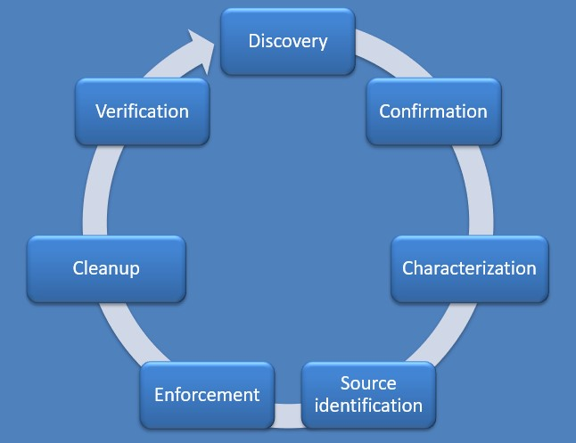
7 Steps of MCM-3 IDDE Implementation
The SWMP Template uses this approach to IDDE.
There are many ways to implement IDDE
DWFS is an integral part of MCM-3 IDDE activities.

Slide 5
Dry Weather Field Screening (DWFS) An Integral Part of the MCM-3 IDDE Program

Slide 6
Step 1: Discovery (Includes DWFS)
Stormwater illicit discharges (IDs) must first be “discovered”, and not just by DWFS.
Discovery includes any visual sightings or reports of potential IDs.
DWFS, PW crews, police and fire, citizens, agencies, organizations.
Discovered and reported potential IDs must next be confirmed to be a true ID. The “discharge” of non-IDs might be:
Authorized under OKR04 or another OPDES or NPDES permit.
Natural flows (ground water seeps, springs, etc.)
Natural environmental conditions (cloudiness, color, odor)
Intermittent or single episode that is no longer present or evident.
Confirming a true ID triggers the full 7-step IDDE sequence.

Slide 7
“DWFS” References in OKR04
MCM-3 Parts V.C.3.a.i – viii intermingles DWFS with “source-tracking”.
Part I: Definitions and Acronyms – no definition of DWFS.
OKR04’s references to “Dry Weather Field Screening” and “DWFS” are:
Part IV.B.1.d.ii requires DWFS program update for TMDLs.
Part V.C.3.a requires your IDDE program (MCM-3) to include DWFS.
Part V.C.3.a.v lists DWFS inspection frequencies by MS4 Category.
Exhibit II, Table 2-1 repeats the MCM-3 DWFS requirements.
Parts V.C.3.a.i – viii lists actions to take to implement the MCM-3 IDDE program, including DWFS.

Slide 8
MCM-3: DWFS Inspection Frequency
OKR04 Table V-4: Minimum Frequency of Dry Weather Field Screening
 | Category 1 | Category 2 | Category 3
DWFS at all identified outfalls | 20% per year ' | 40% per year ' | 40% per year '
DWFS at high priority areas | Once per year | One per year | Once per year
Previous OKR04 did not specify frequency of conducting Dry Weather Field Screening (DWFS) inspections.
Note 1: The number of outfalls screened shall be rounded up to the nearest integer.

Slide 9
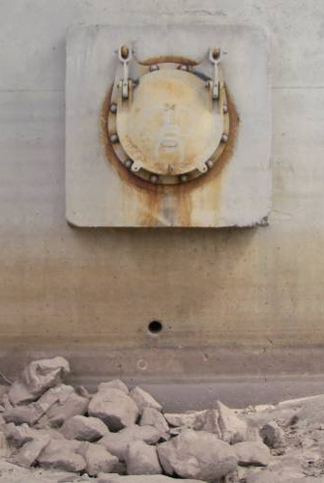
Purpose of DWFS Inspecting
Dry weather means no runoff.
MS4 “outfalls” should not flow.
DWFS flows at outfalls mean potential illicit discharges.
DWFS flows trigger “Source Tracking” inspections.
You might identify the illicit discharge source with DWFS, but mostly DWFS triggers a Source-Tracking inspection.

Slide 10
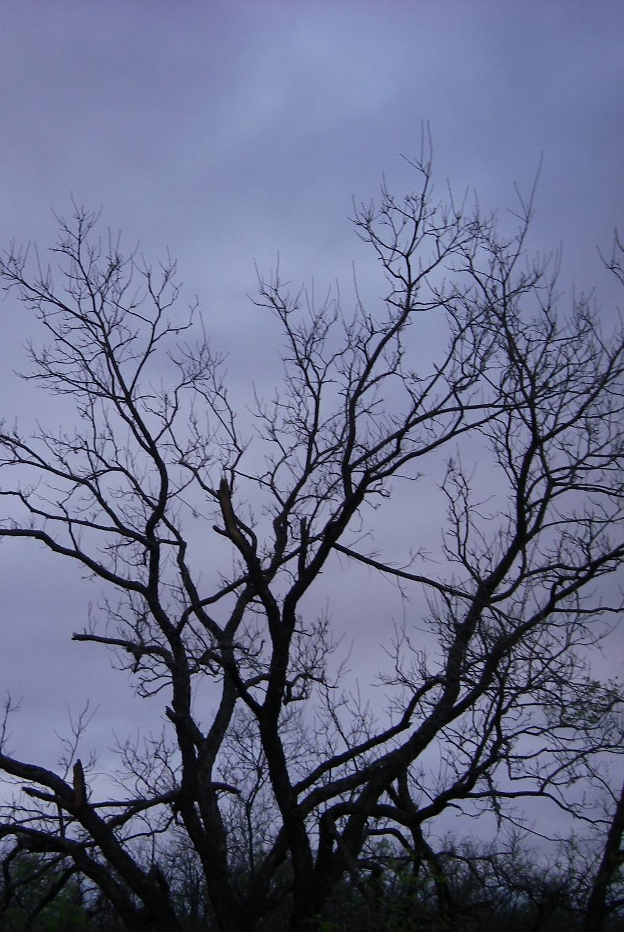
Defining Dry Weather
OKR04 does not define “dry weather” = flexibility.
E.g., after 72 hours with less than 0.10 inches of rain.
Or, 48 to 72 hours after rainfall events having runoff.
Rainfall patterns are often spotty within an MS4.
Expect parts of your MS4 to have heavy runoff, but not all.

Slide 11
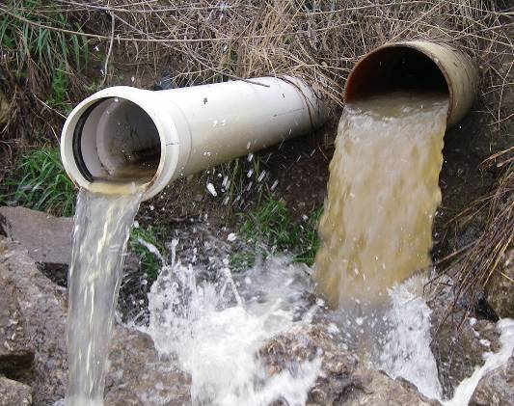
Defining “Outfalls”
OKR04 does not define “outfall”.
Stormwater Guidance nationally uses term loosely:
MS4 discharge points, and
Illicit discharge points.
OKR04 cites “outfall” only 4 times:
2 citations associated with DWFS (in Table V-4 DWFS frequencies)
2 citations associated with maps (outfall locations and receiving streams of outfall discharges).
DEQ has always allowed local flexibility.

Slide 12
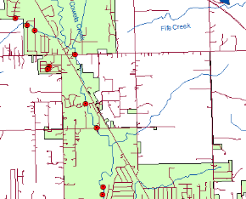
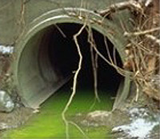
Proper Number of DWFS Outfalls
No OKR04 minimum requirement.
Most MS4 areas are 15 – 25 square miles in size.
Phase I sets DWFS limit of 500 outfalls.
Tulsa is ~200 sq. mi. so 20 sq. mi. = 50.
Lately, DEQ said a MS4 having 8 was too few.
INCOG has always recommended 25 – 50 for average MS4 size.
Prepare to change them frequently.

Slide 13
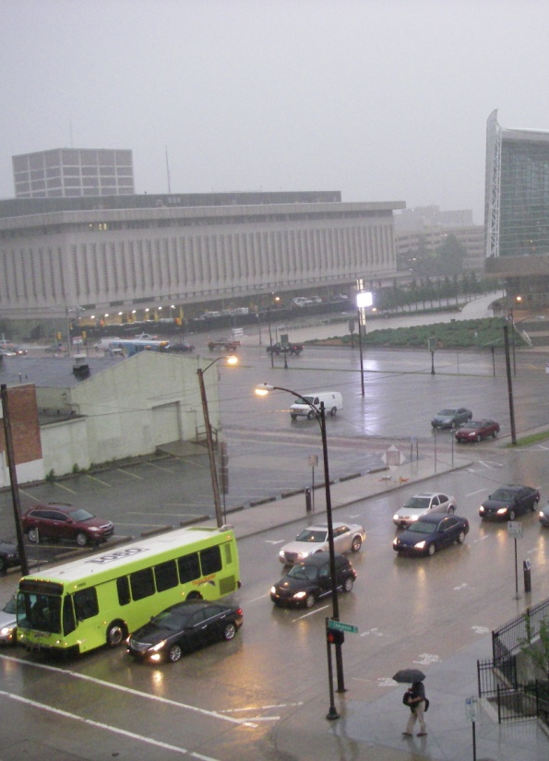
Selecting DWFS Outfalls
OKR04 has no criteria for selecting DWFS outfalls.
Rely on field observations, not office maps.
Select DWFS sites with no flow in dry conditions.
Ease of access, safety and private property permissions.
Diversify land uses and potential I.D. sources.
Prioritize 303(d) and TMDL watersheds and waterbodies.
Spread sites over entire MS4 with focus on priority areas.

Slide 14
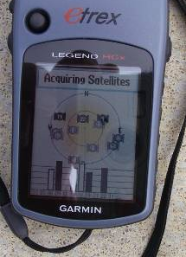
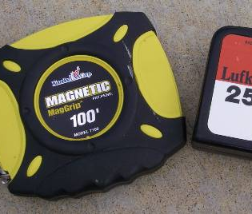
Site Location Records
Record sites on a map and assign a Site Number.
Take pictures of each site (initially and when there are changes).
Obtain site map position “lat-long” coordinates (either by field GPS unit or from a GIS map).
Obtain aerial photos of each site and surrounding land uses (paper or GIS).
Make field distance measurements (tape measure, pacing or a visual estimate).

Slide 15
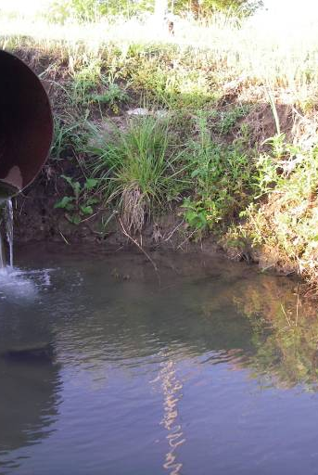
When To Go Out
DWFS can be done in any season.
Normal business hours and workdays.
Plan for 6-10 sites per day at most.
Make time for prep, travel, making observations, paperwork.
Can do a portion of sites each season.
Consider safety factors (temperature extremes, thick weeds, etc.)
Follow Table V-4 as a guide for the minimum DWFS frequency.

Slide 16
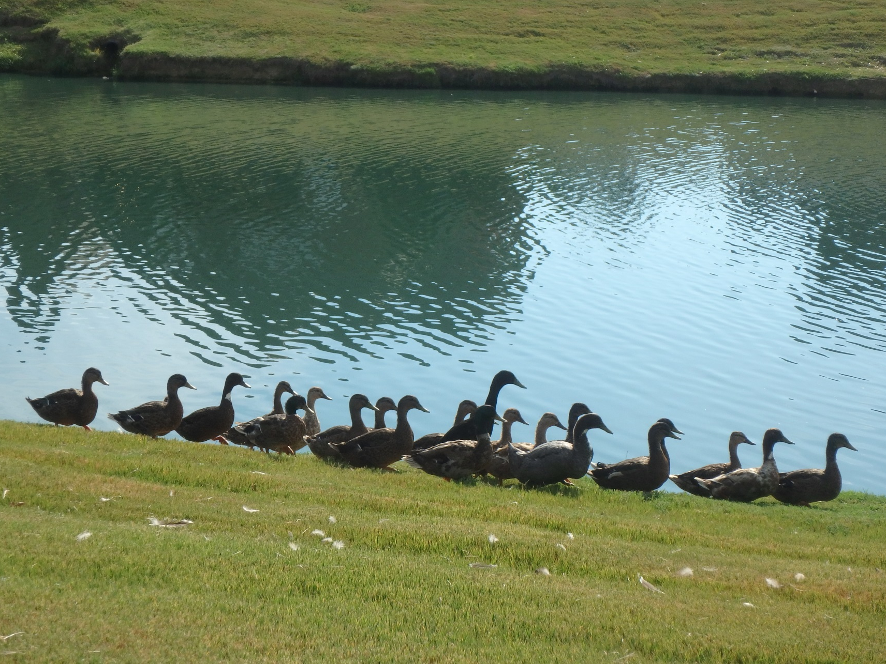
Play Detective
Possible bacteria sources: Birds nearby? Confined animals? Septic systems? Sanitary sewer overflows or leaking pipes?
Is the turbidity coming from a nearby construction site? A parking lot or road? An industrial discharge?
Are algal “blooms” being caused by nutrient chemical discharges, residential over-fertilization or wildlife?
Is the dead vegetation caused from a toxic discharge?

Slide 17
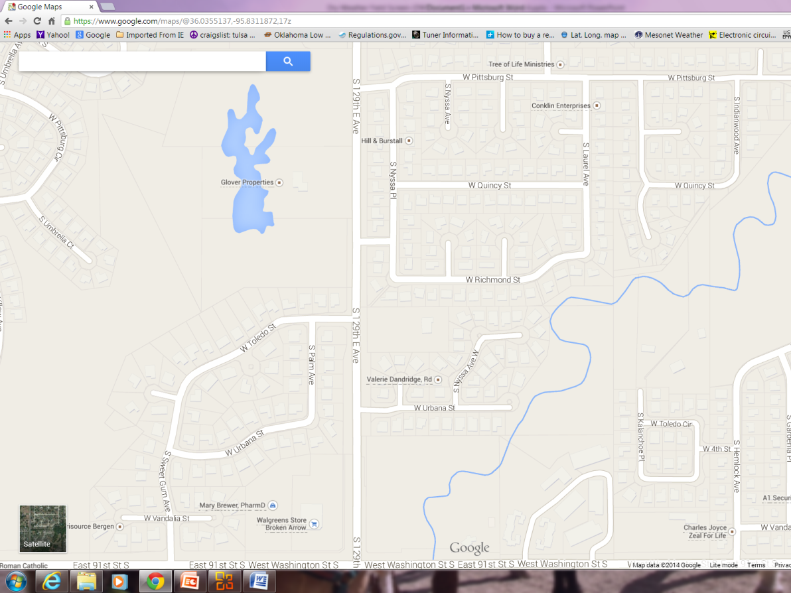
Existing Water Chemistry Data
Sources of existing water chemistry data:
From past MS4 testing.
From state agencies (INCOG, DEQ, Blue Thumb, OWRB, etc.).
Nearby water plants and wastewater plants.
Use this data to determine what is typical for surface waters in your MS4, for runoff flow discharges, and for wastewater effluent in your area.
Baseline data allows comparisons with future data.

Slide 18
Preparing for DWFS Inspections
Written Procedures: SOPs, SWMP, local guidance.
Calibrate instruments before starting.
Proper storage of instruments, chemicals and supplies.
Carry extra batteries, pencils or pens, field forms, etc.
Wear the right clothing and safety gear.
Keep your vehicle well maintained.
Carry a cell phone and emergency numbers and addresses with you.
Work in pairs as much as possible.
Know how to deal with skeptics and property entry refusal.

Slide 19
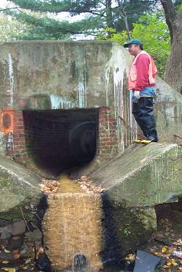
Field Observations
Field notes of any observations of interest.
What are the origins of unusual flow?
What are visual and chemical aspects of the flow?
What is the volume (e.g., gal./min.) of discharge flow?
Colors, odors, soil stains, dead vegetation, etc.
Use “check-box” field forms.
Try not to change data types on forms too much, it causes headaches with analysis.

Slide 20
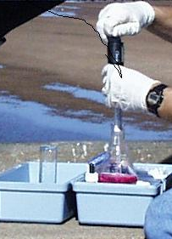
DWFS Leads to Source-Tracking
DWFS is the first step in locating illicit discharges.
Visit sites that should have no permanent flow.
If flows are found, this triggers Source-Tracking.
Sources that are often found at time of DWFS:
Construction or industrial sites.
Trickle channels or small pipes from a facility.
All unknown discharges must be investigated.
Source-tracking can be lengthy and complex.
Greater technical skills are needed.
DWFS requires the use of field test kits, and possible lab analysis.

Slide 21
IDDE Next Steps After Discovery Confirmation Characterization Source Identification

Slide 22
7 Steps of MCM-3 IDDE Implementation
“Discovery” is the finding or reporting of a potential ID
Follow-Up To Discovery of a Potential Illicit Discharge

Slide 23
Steps Needed After Discovery
Step 1 Discovery refers to the initial reporting of or finding of a potential stormwater Illicit Discharge (ID).
Step 2 Confirmation is needed to verify that what was observed or reported is actually an ID which must be addressed by OKR04.
Step 3 Characterization involves the quantitative aspects of the confirmed ID:
What are the pollutants?
What are the pollutant concentrations and aerial extent of the pollution?
What are the dangers to the public and environment?
Step 4 Source Identification involves “Source Tracking” activities to locate the source of the ID for cleanup and possible enforcement.

Slide 24
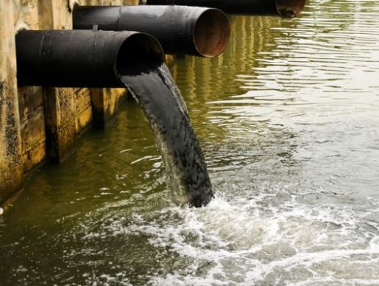
Step 2: Confirmation
Many IDs are transient, sporadic events that are Discovered initially but lose all traces of evidence after a short time.
Concrete washout into creeks.
Dump or spill of chemicals with colors or odors.
OKR04 Part V.C.3.a.ii requires the MS4 to investigate a “potential illicit discharge” within 72 hours of discovery:
“Trace or investigate the source of an illicit discharge. The investigation shall take place within 72 hours of the receipt of any complaints, reports or monitoring information that indicates a potential illicit discharge”
This Photo by Unknown Author is licensed under CC BY-NC-ND

Slide 25
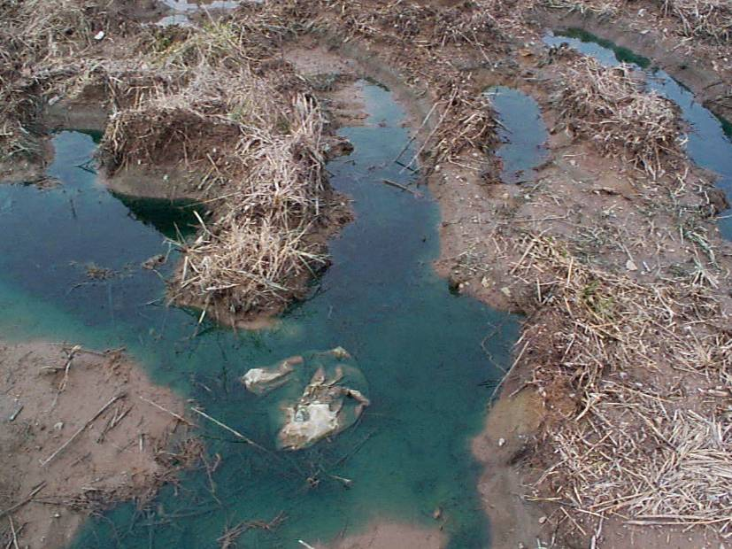
Confirmation Procedures
Most “Discovery” of IDs will be based upon visual evidence.
Colors, odors, fish kills, stains, containers, vegetation, witnesses, etc.
Confirmation involves 2 actions:
Verify that the discovered pollutant exists or the event happened.
Verify that the pollutant discharge is not authorized and thus it is “illicit”.
Even pollutant IDs that are no longer observable can still be “confirmed” (witnesses, photos, security cameras).
Confirmation verifies that some type of pollution event did occur.
Step 3 Characterization will identify the ID pollutant if not initially known.

Slide 26
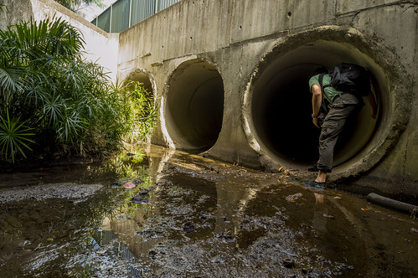
Confirmation Suggestions
Begin with what was found (visual evidence, witness reports).
Suspected pollutants can often be confirmed with test kits.
Confirmation won’t need lab testing, but Characterization might.
Suspected dangerous chemicals:
STAY AWAY! You don’t have the training or equipment.
Contact HAZMAT, Fire Dept., other professional resources.
Even vapors from spills can be toxic (e.g., H₂S gas).
Never enter “Confined Spaces” without proper training and equipment.
The goal of Step 2 Confirmation is not to identify specific pollutants, only that an illicit discharge of something has occurred.
This Photo by Unknown Author is licensed under CC BY

Slide 27
Step 3: Characterization
Step 3 involves 2 actions:
1. Pollutant Identification:
Try to identify both the chemical and its concentration.
Test kits, lab data, containers, witnesses, PRP.
2. Aerial Extent of Pollution: (metric as well?)
Size of land surface (ft², acres)
Length of stream (feet, miles)
Location of pollution event
This Photo by Unknown Author is licensed under CC BY-NC-ND
Your data may be needed in a civil or criminal court action, and you may be called to testify about the data and defend its quality.

Slide 28
Step 4: Source Identification
Step 4 is the “Source Tracking” part of the MCM-3 IDDE program.
Many ID sources are obvious and easy to find; others are difficult:
VISUAL: Flowing pipes, trickle channels, sheet flows (track upstream).
CHEMISTRY: measure / test kit data upstream of site for chemical presence.
LOCALIZED EPISODIC: only a single location with no indicators of what, when, or by whom. May only be dead vegetation, stains or odors (no chemicals present).
PRP (Principal Responsible party) may be easy to identify, or perpetrator may never be found (e.g., illegal dumping).
This Photo by Unknown Author is licensed under CC BY-NC-ND

Slide 29
Steps 5 & 6: Enforcement And Cleanup
Steps 5 and 6 are administrative, for the most part.
Once the ID source has been identified, the MS4 must ensure that the PRP (Principal Responsible party) is held responsible for cleanup and restitution, if applicable.
PRP: negotiate cooperation for PRP cleanup, or take enforcement action to force PRP to cleanup and/or pay for 3rd party cleanup.
NO PRP: MS4 must expend resources for cleanup.
This Photo by Unknown Author is licensed under CC BY-NC-ND

Slide 30
Step 7: Verification (of Cleanup)
Regardless of who is responsible for cleanup (the PRP or the MS4), the OKR04 Program Manager needs to verify that the ID has been effectively cleaned up and the discharge source is removed.
Some PRPs may try to obfuscate, refuse to cooperate or do insufficient cleanup.
Enforcement penalties may be the only motivation for some PRPs.
For large spills that pose a public or environmental risk, there are state resources beyond local HAZMAT that can be applied.
For each event, keep written records of all actions taken: who, what, where, when, how and why. Include photos and correspondence.
Make sure MS4 management is kept informed of all actions taken.
This Photo by Unknown Author is licensed under CC BY-NC-ND

Slide 31
Questions ?
Vernon Seaman
Manager, Envir. and Energy Planning
INCOG
Two West 2nd Street, Ste 800
Tulsa, OK 74103
(918) 579-9451
vseaman@incog.org

